Slide 1
3.Cost Accounting
Introduction :
Costing is a specialized branch of accounting. It has been developed because of limitations of financial accounts. In the present day it is absolutely necessary that a business concern should operate its activities with utmost efficiency and at the lowest cost. The need for determination and control of costs necessitated new set of principles of accounting and thus emerged ‘cost account’ as a specialized branch of accounting

Slide 2
Definition
In the words of Harold J. Wheldon “costing is the classifying and appropriate allocation of expenditure for the determination of the cost of the products or services, and for the presentation of suitably renamed data for purpose of control and guidance of the management”.

Slide 3
Cost Accounting :
Cost Accounting is the process of classifying, recording, allocating and reporting the various costs incurred in the operation of an enterprise.
Cost Accountancy:
Cost Accountancy is the application of costing and cost accounting principles methods and techniques to the science, art and practice of cost control and ascertainment of profitability. It includes the presentation of information for the purpose of decision making.

Slide 4
Objectives of Cost Accounting
Ascertainment of cost:
“Ascertainment of cost is the process of determining the actual cost of a product, job, process, or service.”
— ICMA (Institute of Cost and Management Accountants)
Determination of selling price:
It involves deciding a price that covers all costs and provides a reasonable profit margin, while also remaining competitive in the market.

Slide 5
Control cost:
“Cost control is the process of regulating and keeping costs within predetermined limits so as to achieve the desired profit.”
— ICMA
Preparation of financial statements:
Cost accounting provides detailed information about costs, which complements financial accounting for accurate reporting and decision-making.
Formulation of operating policies:
Production,Pricing,Procurement,Labor,Inventory

Slide 6
Advantages and Limitations of Cost Accounting
To the Management:
Ascertainment of costs
Price fixation
Inventory control: Example
Material Records – Maintains ledger accounts for all materials (received, issued, and balance).
ABC Analysis – Categorizes inventory based on value and importance:
A-items – High value, strict control
B-items – Moderate value, medium control
C-items – Low value, simple control

Slide 7
Measurement of efficiency:
Ex: Standard Costing:Sets standard (expected) costs for materials, labor, and overheads. Efficiency is measured by comparing actual cost with standard cost
Managerial control:
Ex: Budgetary Control and Standard Costing and Variance Analysis

Slide 8
Limitations of Cost Accounting
Complexity and Costly System
Limited Scope in External Reporting
Not Universally Applicable
Expensive
Problem of reconciliation of cost and financial accounts

Slide 9
Helpful in maximizing the profits
Useful in the period of depression and competition
(low demand, falling prices, and reduced sales)

Slide 10
Cost center
A cost center is a department or function within a company that incurs expenses but doesn't directly produce revenue or profits.
Its primary purpose is to ensure that the business operates efficiently and that all needs are met.
Its contributions are essential to the company's overall functionality even though it doesn't bring in any money.
Ex:Various departments play specific roles in all companies. Some, like sales, generate revenue, while others, such as human resources, provide support without directly contributing to the bottom line.
These supportive units are known as cost centers.

Slide 11
Types of Cost Centers
Service Cost Centers
Service cost centers provide essential services within the organization
Ex: Mailroom and courier services, which manage the distribution of external and internal correspondence
Travel and logistics, which is responsible for organizing employee travel.

Slide 12
b. Production Cost Centers:
Provides support to production but does not produce output.
Example: Maintenance department, Power house, Tool room
They don't sell the final product directly to customers but help shape resources to become a finished product.
Ex: Quality control inspects products to ensure they comply with safety and regulatory standards, preventing recalls and unhappy customers

Slide 13
c. Administrative Cost Centers:
Administrative cost centers handle administrative tasks (like records management) that are responsible for organizing and storing company documents

Slide 14
Elements of Cost
Knowing the components of cost is important to properly calculate the overall cost incurred in the manufacture of goods or delivery of services.
The costs are categorized into three broad types: material costs, Labor costs, and overhead costs. Material costs are the costs incurred for raw materials or supplies to be used in production.

Slide 15
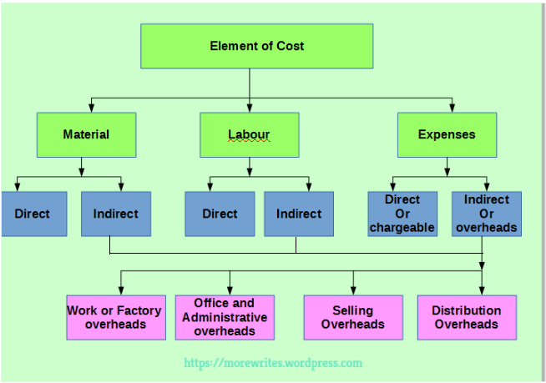

Slide 16
Divisions of cost
Prime Cost = Direct materials + Direct labour + Direct expenses
Factory cost = Prime cost + Factory over heads
Cost of production = Factory cost + Administrative overheads
Cost of sales = cost of production + selling and distribution overhead.

Slide 17
Direct Materials:
Materials which are present in the finished product or can be identified in the product are called direct materials. For example, cloth in dress making; materials purchased for a specific job etc. Note: However in some cases a material may be direct but it is treated as indirect, because it is used in small quantities or due to any other suitable reason.

Slide 18
Example
Wood used in furniture
Cotton used in shirts
Steel used in a car
Flour in bread
Cement in construction
leather in shoes
Steel in machinery

Slide 19
b) Direct Labour:
Labour which can be identified or attributed wholly to a particular job, product or process or expended in converting raw materials into finished products is called direct labour. For example, labour engaged on the actual production of the product in carrying out the necessary operations for converting the raw materials into finished product

Slide 20
Examples
Carpenter making furniture
Tailor stitching clothes
Factory worker assembling a car

Slide 21
Direct expenses:
It includes all expenses other than direct material or direct labour which are specially incurred for a particular product or process. Examples of direct expenses includes – excise duty, royalty, surveyor’s fees etc

Slide 22
Indirect materials:
Materials which do not normally form part of the finished product are known as indirect materials These are :
Stores used for maintaining machines and building (lubricants, cotton, waste, bricks etc).
Stores used by service department like power house, boiler house, canteen etc.

Slide 23
Indirect labour:
Labour costs which cannot be allocated but can be apportioned to or absorbed by cost units or cost centers is known as indirect labour. Examples of indirect labour includes – charge hands and supervisors; maintenance workers; etc.

Slide 24
Indirect expense:
Expenses other than direct expenses are known as indirect expenses. Factory rent and rates, insurance of plant and machinery, power, light, heating, repairing, telephone etc., are some examples of indirect expenses.

Slide 25
Overheads:
It is the aggregate of indirect material costs, indirect labour costs and indirect expenses. The main groups into which overheads may be subdivided are the following:
(i) Production or Works overheads
(ii) Administration overheads
(iii) Selling overheads
(iv) Distribution overheads

